Slide 1
sCMOS
Orla Hanrahan, PhD
Application Specialist Life Science Imaging

Slide 2
Scientific imaging trade-offs…
Today’s imaging detectors exhibit trade-offs between key performance parameters…
Low noise
Rapid frame rates
Wide dynamic range
High resolution
Large field of view
sCMOS technology overcomes trade-offs

Slide 3
Scientific CMOS (sCMOS)
is unique in
simultaneously offering:
Extremely low noise (without multiplication)
Rapid frame rates
Wide dynamic range
High QE
High resolution
Large field of view

Slide 4
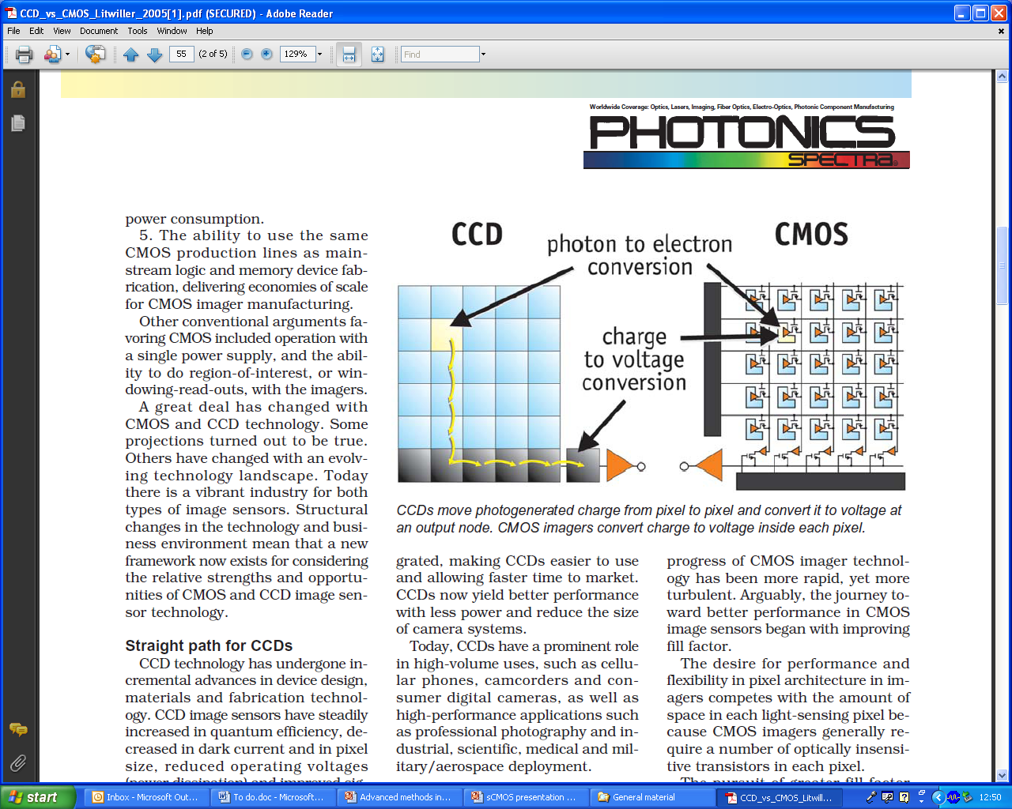
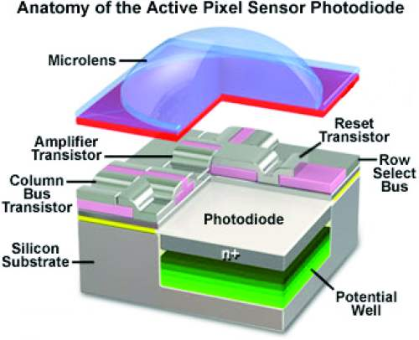

Slide 5
sCMOS vs other imaging technologies…
Sony interline
EMCCD
sCMOS
Sensor format
1.4 MP
1 MP (max.)
5.5 MP
Pixel size
6.45 μm
8 to 24μm
6.5 μm
Max. frame rate
12 fps @ 20MHz
> 30 fps
100 fps
Read noise
4 – 8 e⁻
Negligible (<1 e⁻)
1 e⁻ @ 30 fps
1.3 e⁻ @ 100 fps
QE
~ 60% (FI)
65% (FI) / >90% (BI)
~ 57% (FI)
(excellent red response)
Dynamic range
~ 3,000:1
(@ 11 frames/sec)
~ 8,500:1
(@ 30 frames/sec)
30,000:1
(@ 30 frames/sec)
Darkcurrent
(TE cooled)
0.0003 e/pix/sec
@ -55 ⁰C
0.001 e/pix/sec @ -85 ⁰C
0.07 e⁻/pix/sec @ -30 ⁰C

Slide 6
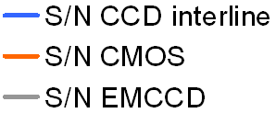
sCMOS vs interline CCD …
sCMOS vs Interline CCD…
(no binning)
sCMOS / CCD merge
sCMOS (6.5 μm)
Interline CCD (6.5 μm)
Signal to Noise Ratio (SNR)
Photons per 6.5 μm pixel area

Slide 7
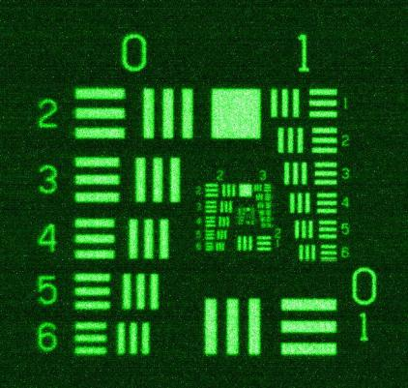
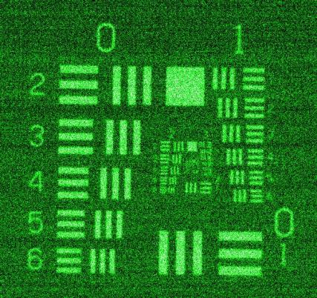
sCMOS vs interline CCD image comparison…
sCMOS –
1.2 e⁻ noise
Sony ICX285 Interline CCD –
5 e⁻ noise
~ 30 ph/pix
622nm

Slide 8
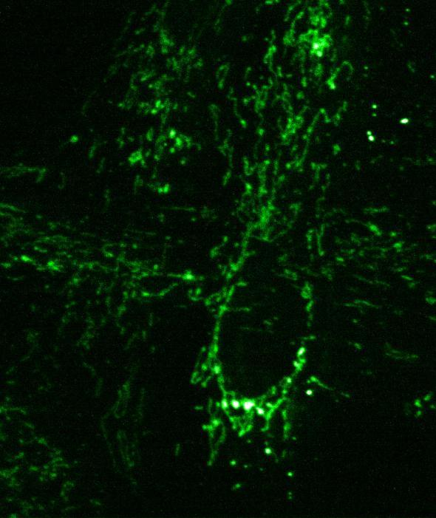
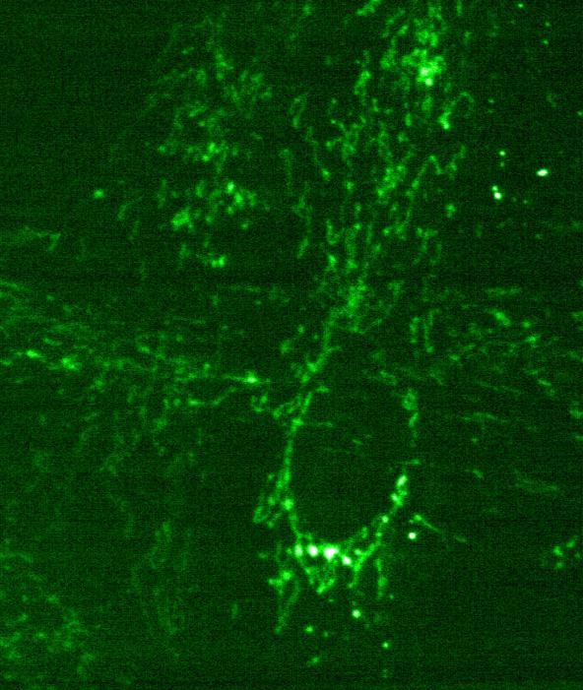
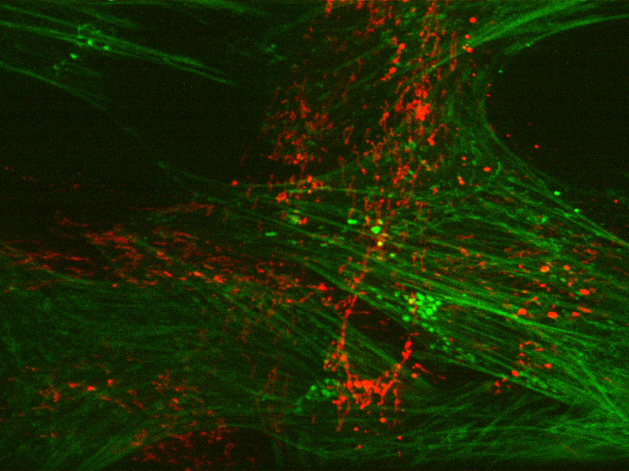
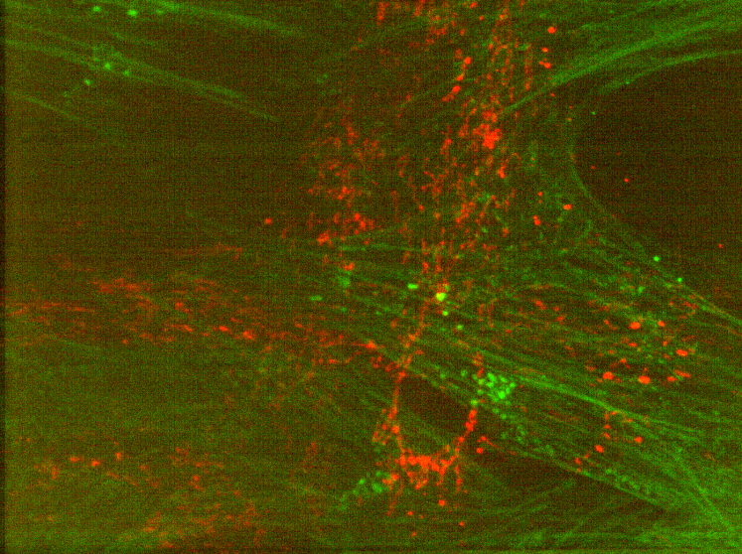
sCMOS vs interline CCD image comparison…
sCMOS
1.2 e @ 400MHz
Interline CCD
5 e @ 20MHz
sCMOS (400MHz; 1.2 e⁻ read noise) vs Interline ICX285 sensor (20MHz; 5 e⁻ read noise)
CSU-X spinning disk confocal microscope (x60 oil objective)
each 100ms exposure
same laser power
displayed with same relative intensity scaling.
sCMOS
2 channels merged
CCD
2 channels merged

Slide 9
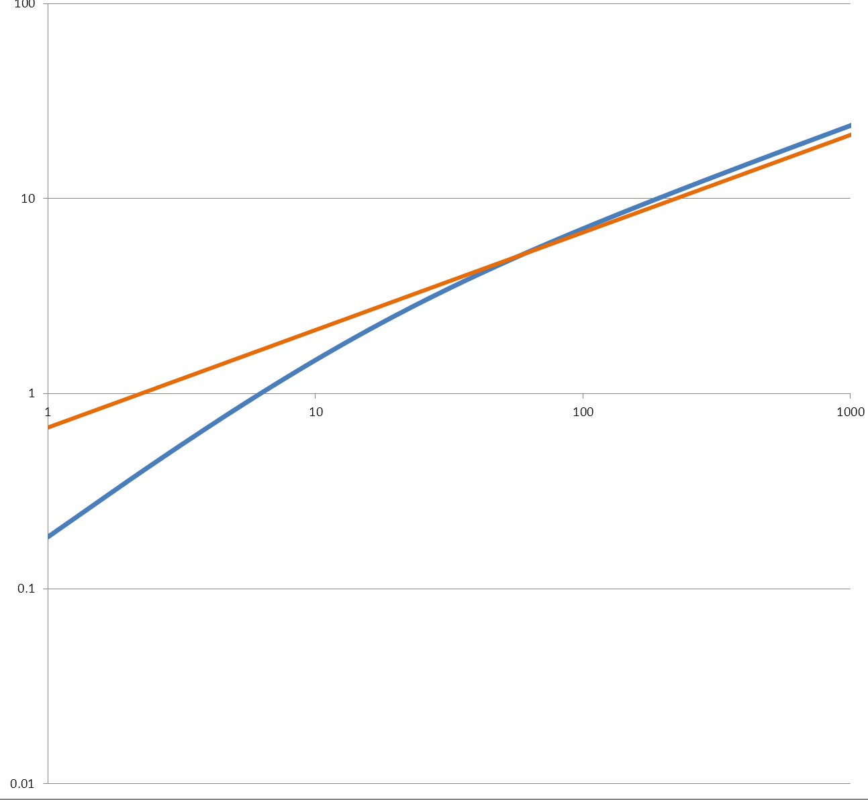
sCMOS vs EMCCD …
sCMOS (2x2 binned) vs Back-illuminated EMCCD
sCMOS / EMCCD cross-over
~ 56 photons/pixel
iXon₃ 888 (13 μm)
sCMOS 2x2 binned (13 μm)
Signal to Noise Ratio (SNR)
Photons per 13μm pixel area
BI EMCCDs can still offer best performance in very low light applications, e.g. single molecule, photon counting, confocal etc…

Slide 10
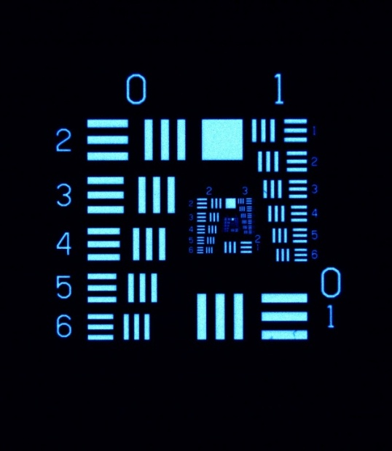
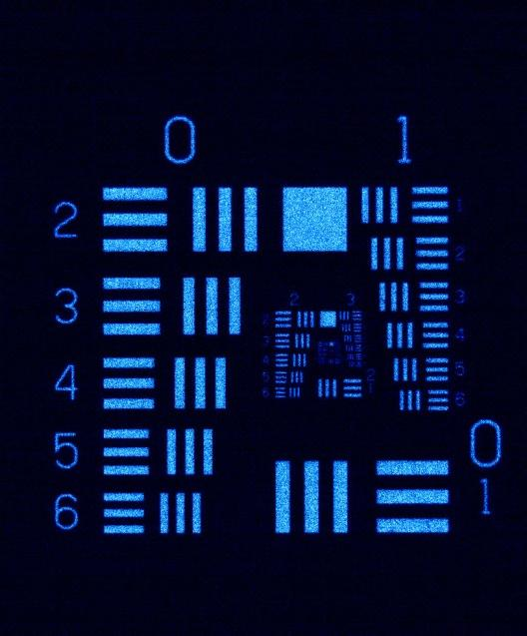
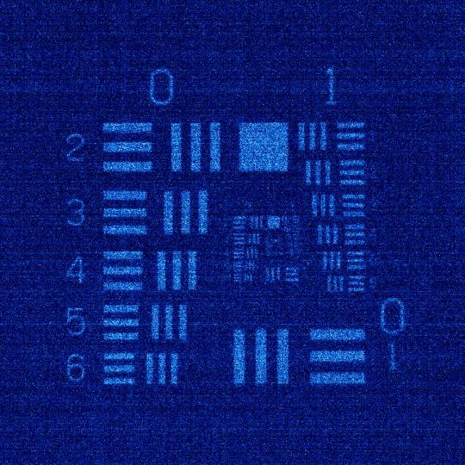
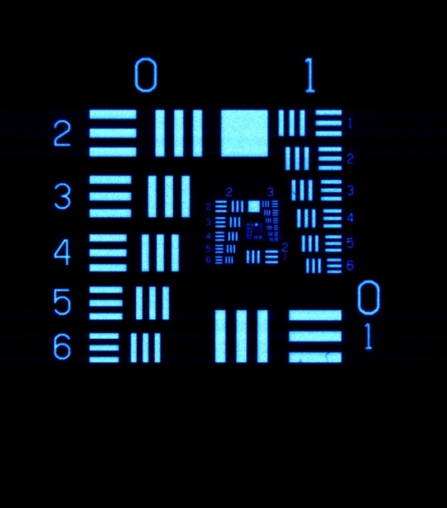
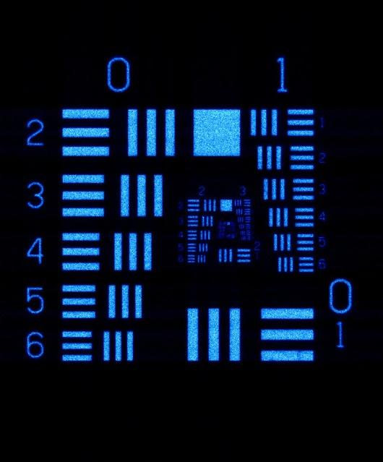
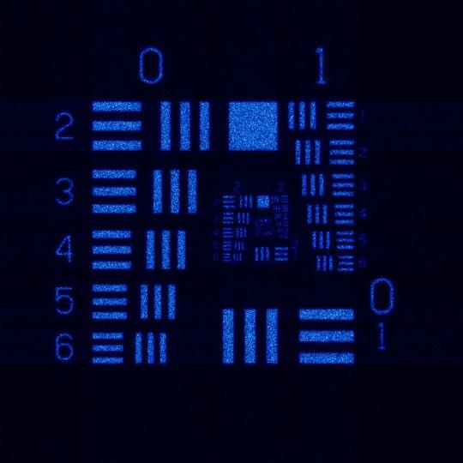
sCMOS vs EMCCD image comparison…
490 photons per pixel
68 photons per pixel
8
photons per pixel
sCMOS
2x2 binned
(13 µm)
EMCCD
(13 µm)

Slide 11
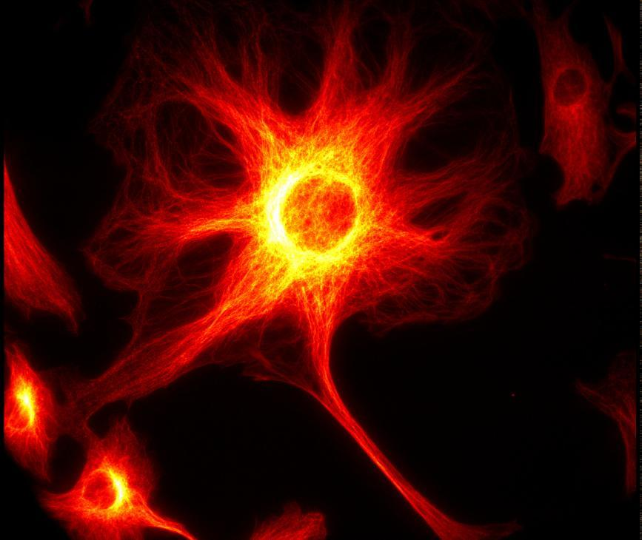
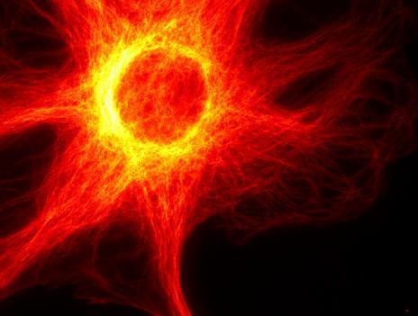
Field of View comparisons….
sCMOS
Sony ICX285 interline
Field of view comparison of two technologies; x60 magnification; 1.25 NA; 5.5 megapixel sCMOS vs 1.4 megapixel interline CCD (each have ~ 6.5 μm pixel pitch).

Slide 12
sCMOS vs interline CCD
Noise Floor (read noise and dark noise) vs exposure
Cooled interline CCD offers better performance for long exposure apps, e.g. bioluminescence detection
Noise Floor (e⁻)
Due to lower darkcurrent,
cooled interline offers lower noise floor at longer exposures (>1 minute)
Exposure time (sec)

Slide 13
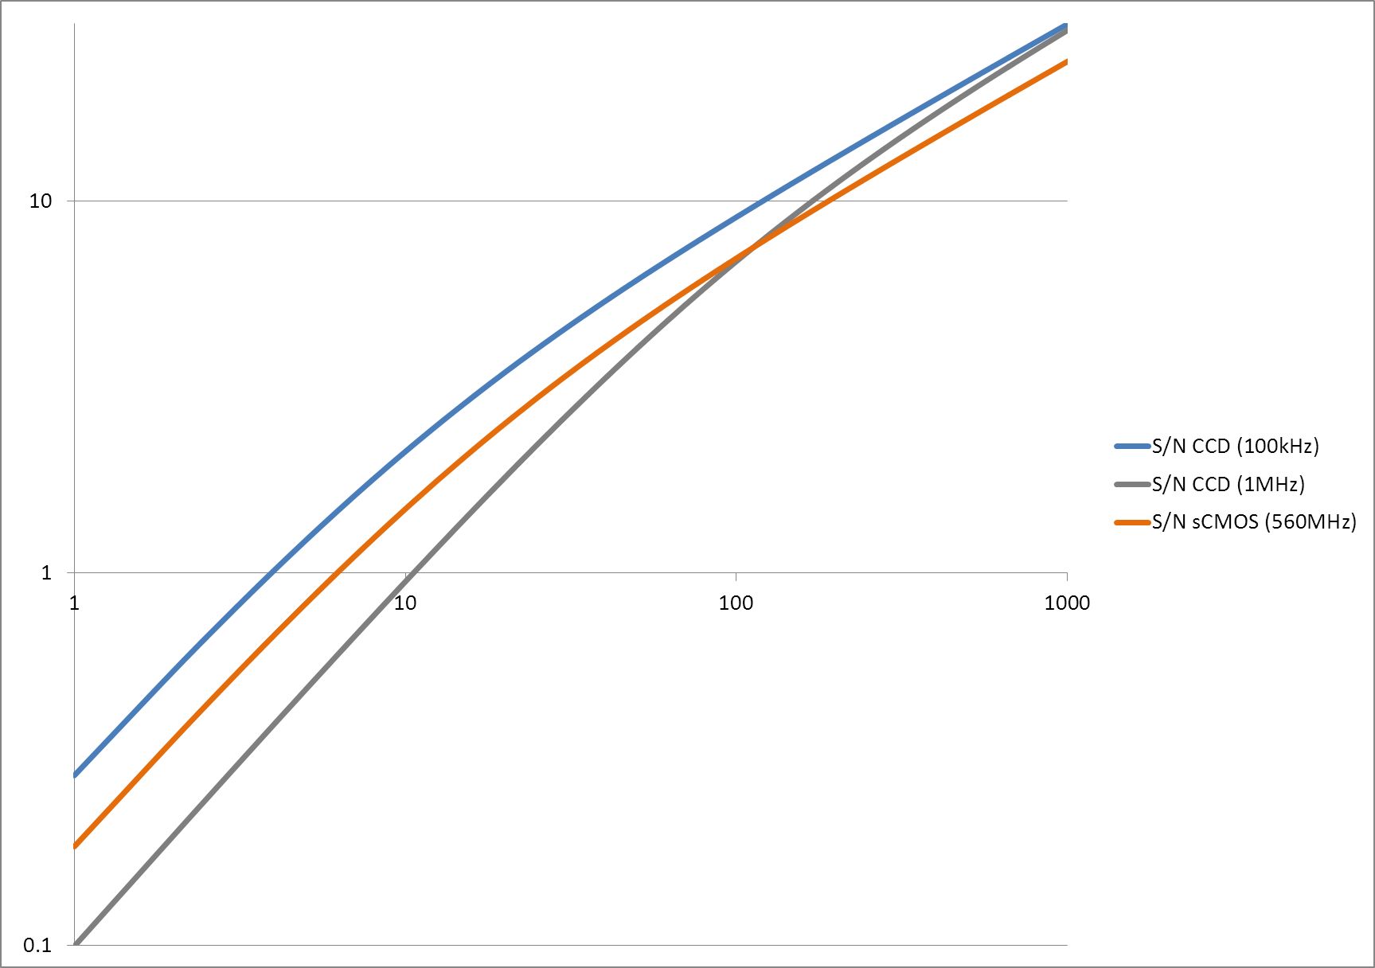
sCMOS vs back-illuminated CCD…
sCMOS (2x2 binned) vs
Back-illuminated CCD…
Signal to Noise Ratio (SNR)
Photons per 13μm pixel area
BI CCDs can still offer best performance in slow readout (typically long exposure) applications

Slide 14
sCMOS was conceptualised to become the ‘new interline’
How to achieve this?
Interline
sCMOS
4 to 8 e⁻
More Sensitive
1e⁻
11-16 fps
Faster
30 fps sustained
< 12-bit
Wider Dynamic Range
> 14-bit
1.4 MP
Larger FoV / Resolution
5.5 MP
‘Snapshot’ exposure
Rolling & Global exposure
Decent image quality
Price

Slide 15
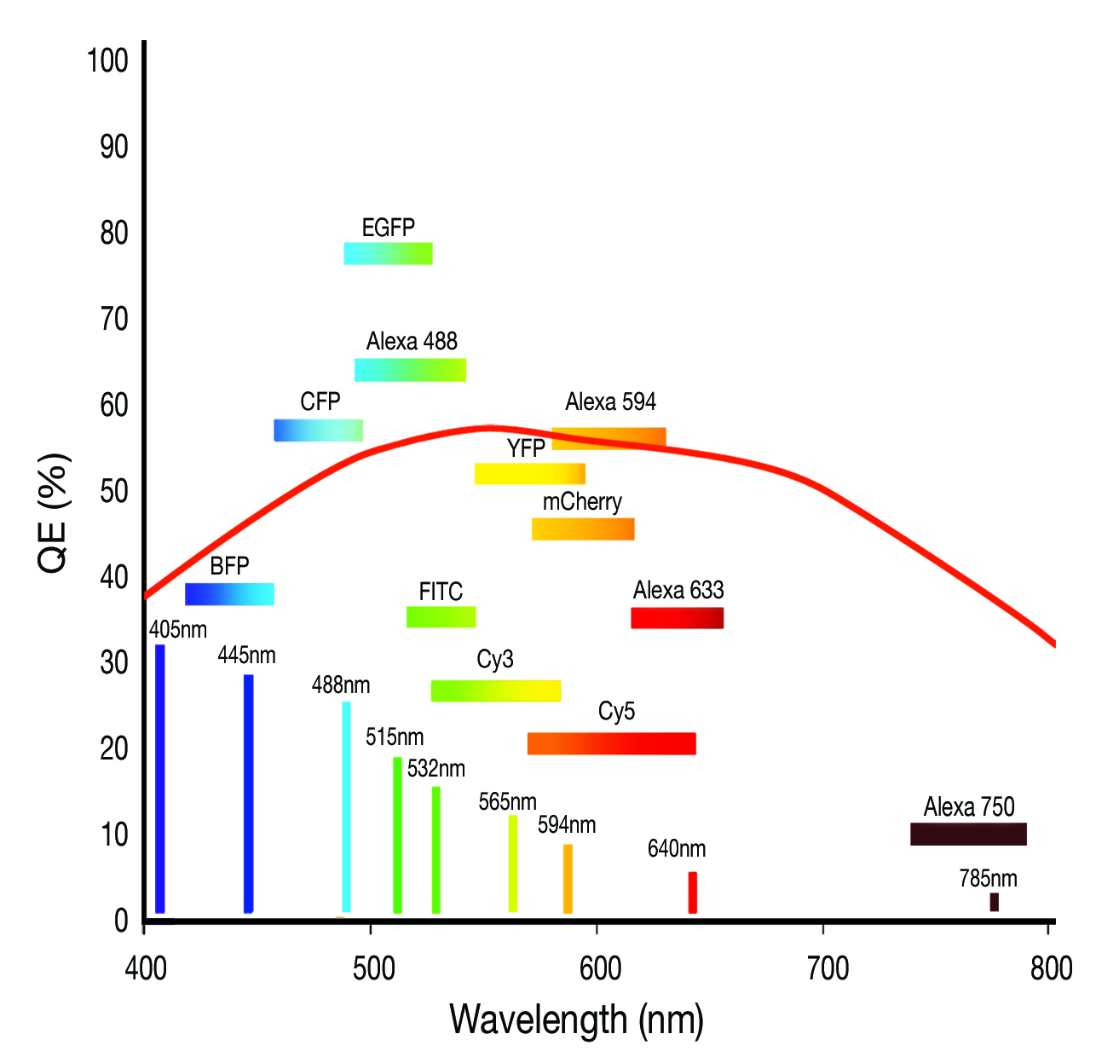
sCMOS QE curve

Slide 16
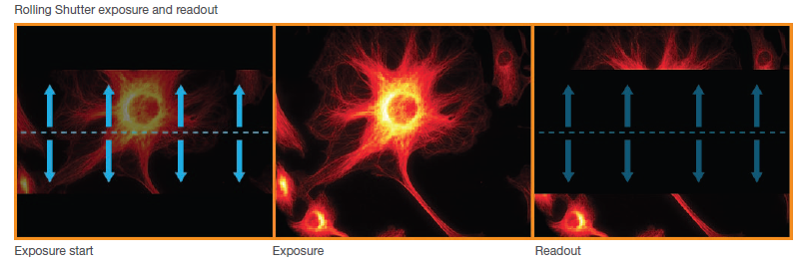
Rolling and Global exposure modes

Slide 17
Rolling or Global?
Rolling shutter
Use when do not require exact correlation in time between two separated regions of the image, e.g. vesicle tracking, calcium waves
Use when no danger of spatial distortion in ‘large’ fast moving objects
To achieve lowest possible read noise (1 to 1.3 e⁻)
To achieve fastest possible frame rates
Global (Snapshot) shutter
This mode is analogous to ‘interline CCD’ snapshot mode of exposure and readout
Use when time correlation between separate regions of image is required
Read noise compromised slightly (2.3 to 2.5 e⁻)

Slide 18
Applications of the sCMOS

Slide 19
Some uses of the sCMOS so far…
SPIM
Motor proteins (myosin)
Laser speckle imaging – blood flow
Vesicle transport
Neural circuits
Cell motility
Calcium signalling
Astronomy

Slide 20
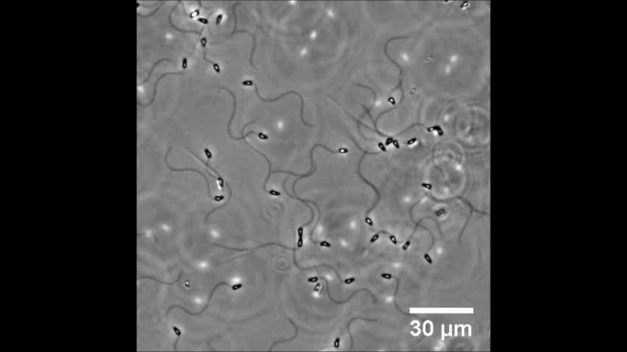
Dr. Jeffrey Guasto, Dept. Of Civil & Environmental engineering, MIT-understanding the biomechanics of sperm cell movement-important for fertilization.

Slide 21
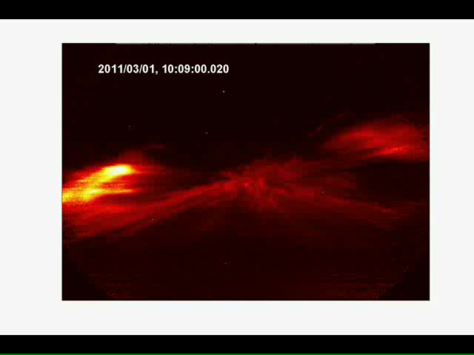
Dr. Robert Marshall, Centre for Space Physics, Boston University - Aurora Breakup event captured with the Neo at 50 fps, full frame
“This data will allow us to make unprecedented measurements of morphology of small-scale auroral structures”

Slide 22
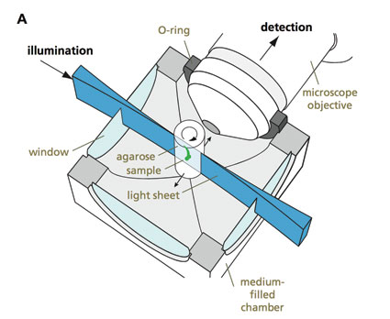

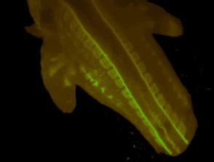
SPIM (Selective Plane Illumination Microscopy)
Dr. Lars Hufnagel, Developmental Biology Unit, EMBL Heidelberg.
Recommendation:
Neo sCMOS
‘Without pushing it to the limit we managed to take 131 planes of the drosophila embryo in just 4 seconds (5.5 megapixels mode), which is practically instantaneous compared to the morphogenetic processes and out-performs by far everything we have tried before. The camera is made for SPIM microscopy!’
Resolution
Field of View
Speed
Optical sectioning even with lenses that have a large working distance and a relatively low numerical aperture
Especially well suited for the investigation of large samples (e.g. embryos) to study features such as growth, migration, morphological changes and gene expression patterns, that require high resolution, while being extended over a large volume.
Single plane illumination significantly reduces photobleaching/phototoxicity
Mouse Embryo

Slide 23
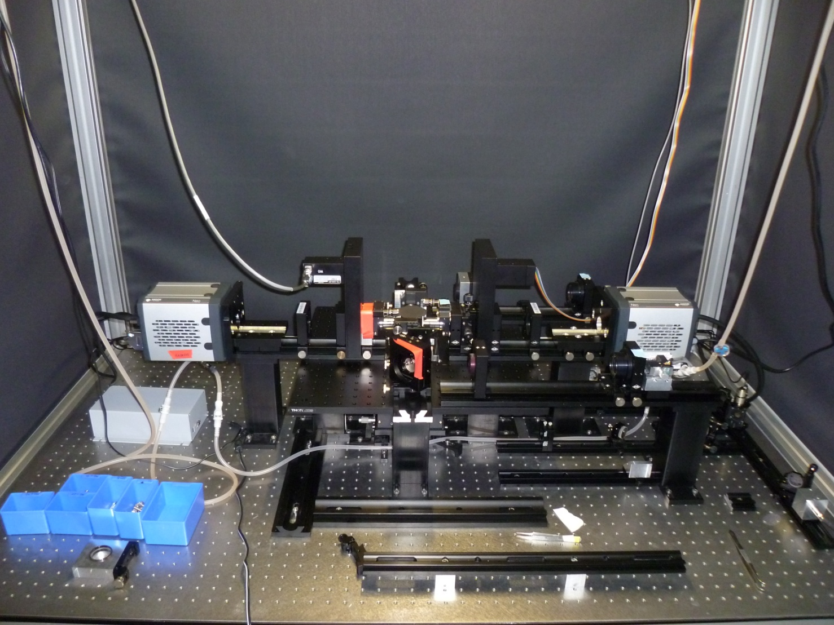
A photograph of a state-of-the-art 4-lens SPIM, courtesy of Uros Krizic of the Hufnagel Lab, EMBL, Heidelberg
Notes:
In this latest implementation, four objective lens are focused onto a specimen.
While two opposing lenses illuminate the specimen with a light-sheet from two opposing directions, the two remaining, orthogonal objective lenses simultaneously generate two images on the two sCMOS cameras. This way we can within a fraction of a second collect four images, each corresponding to one of the four combinations of the illumination/detection lenses. Each of the four images will demonstrate good quality only in a part of an opaque specimen, while all together provide a vastly improved image. (Uros Krzic, Hufnagel lab, EMBL Heidelberg)

Slide 24

Optical cross-sections through a developing Drosophila melanogaster embryo in stage 5/6. Two Neos are used to capture this 3-D structure and one of these can be captured every 20 seconds.

Slide 25
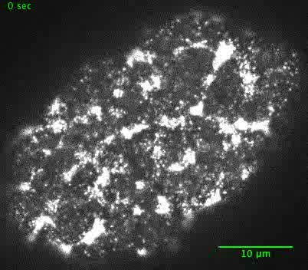
Movie of the motor protein myosin (fluorescently tagged with GFP) in the nematode C. Elegans immediately after Fertilization – movie courtesy of Sundar Naganathan (Grill research group, MPI, Dresden)

